Slide 1

CANDY RUN
Company : C&H
Candycandy Candycandy
Notes:
This game named CANDYRUN, the company of this game is C&H.

Slide 2

Game Play
***Game player will needs to get candy***
**Be carefully for dragon,nail,knife,and monster**
Notes:
This game is a running game. Player should to get candy. Different candy will get different points for score. When the player get candy, the game has some dragon, nail, knife, and monster. Be sure player don’t tough for them, player will always lose ten points .

Slide 3
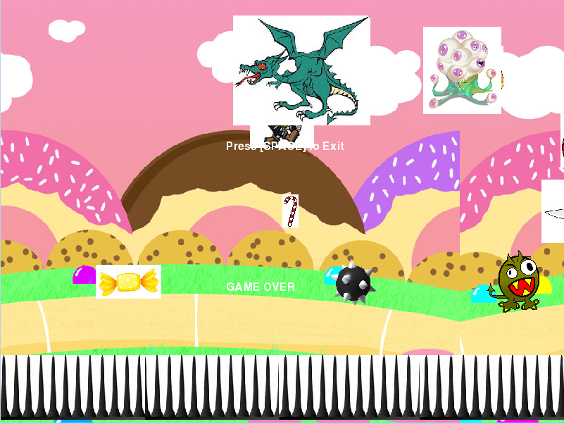
Score:
Notes:
This is game in playing.

Slide 4
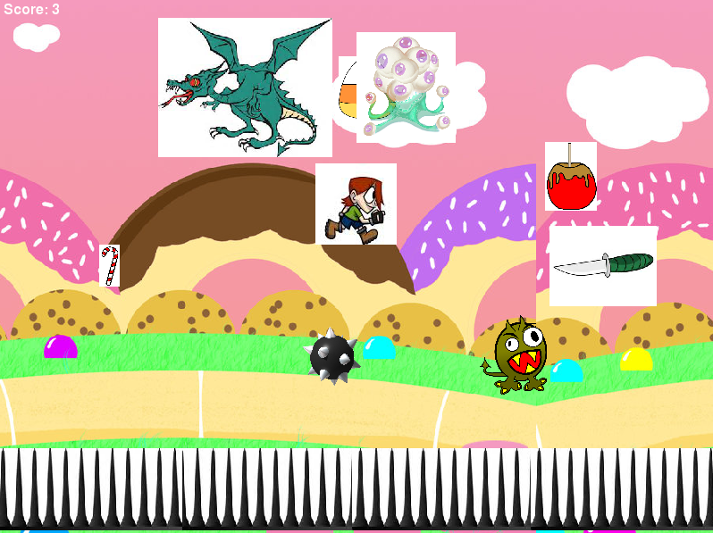
Notes:
This is game in playing.

Slide 5
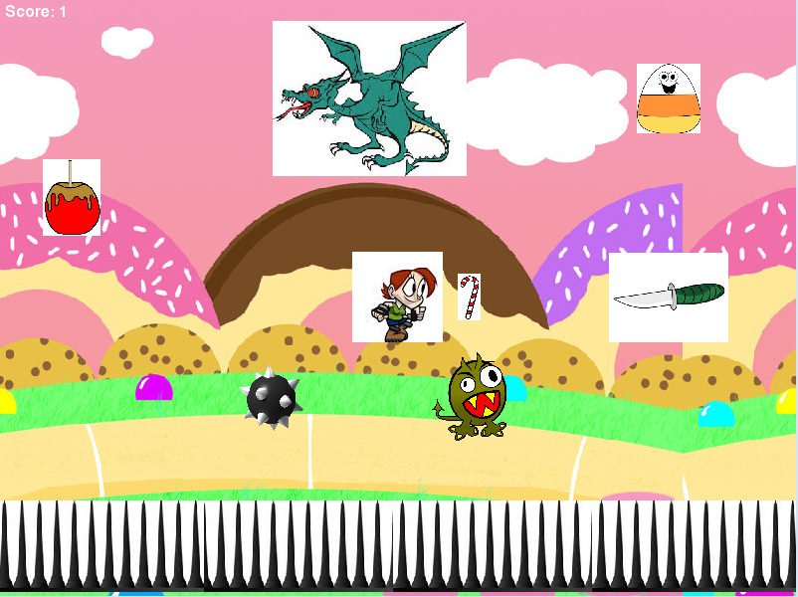
Notes:
This is game in playing.

Slide 6
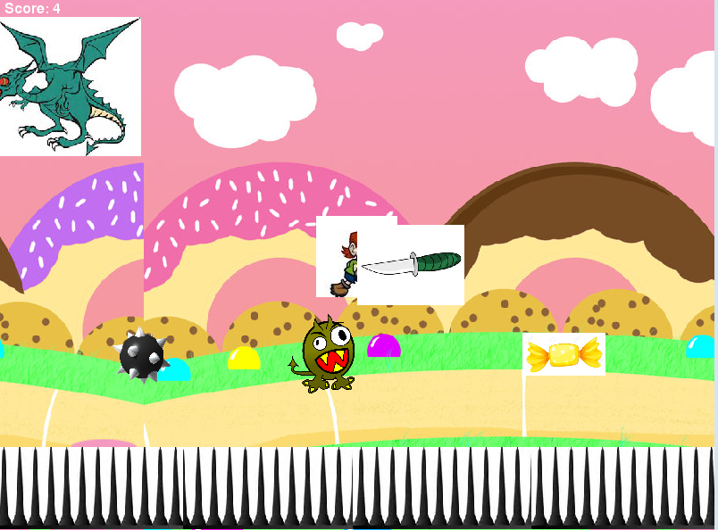
Notes:
This is game in playing.

Slide 7
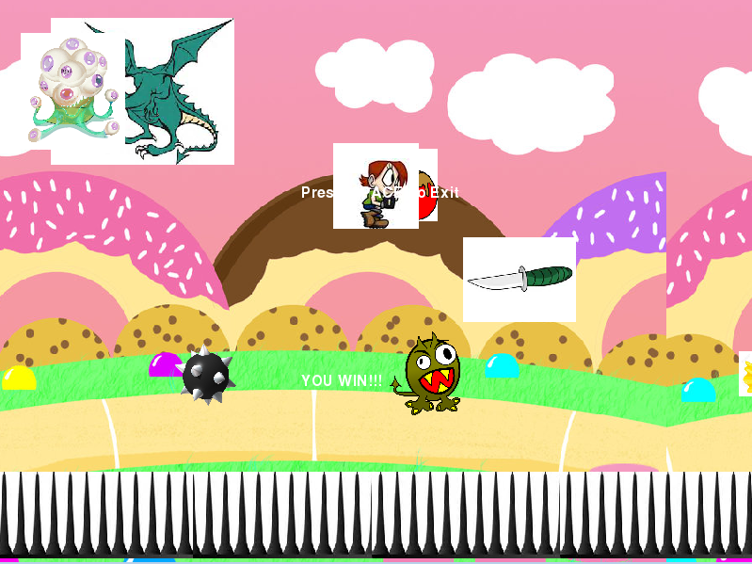
Notes:
This is game in playing.

Slide 8
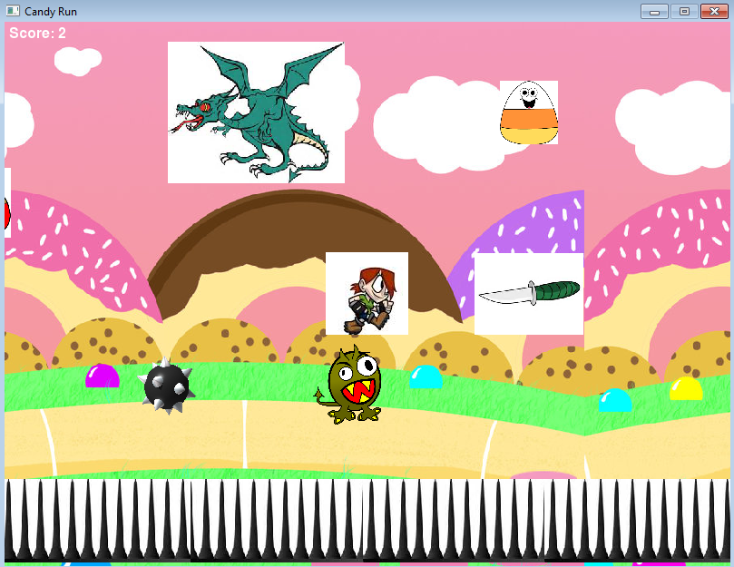
Notes:
This is game in playing.

Slide 9

WINNER
Notes:
When get the score that is great than 25, you are win for the game become a winner.

Slide 10
LOSSER
Notes:
When get the score that is less than 0 for negative, the game will over, you are lose this game.

